Slide 1
Human Nature: An Exploration
Who are we?

Slide 2
Defining Human Nature
A complex mix of our biology, environment, and experiences. It shapes our behaviors, thoughts, and emotions.

Slide 3
Nature's Influence
Genes and evolution play a significant role in human behavior. Instincts and physical traits are inherited, influencing our survival and interactions.

Slide 4
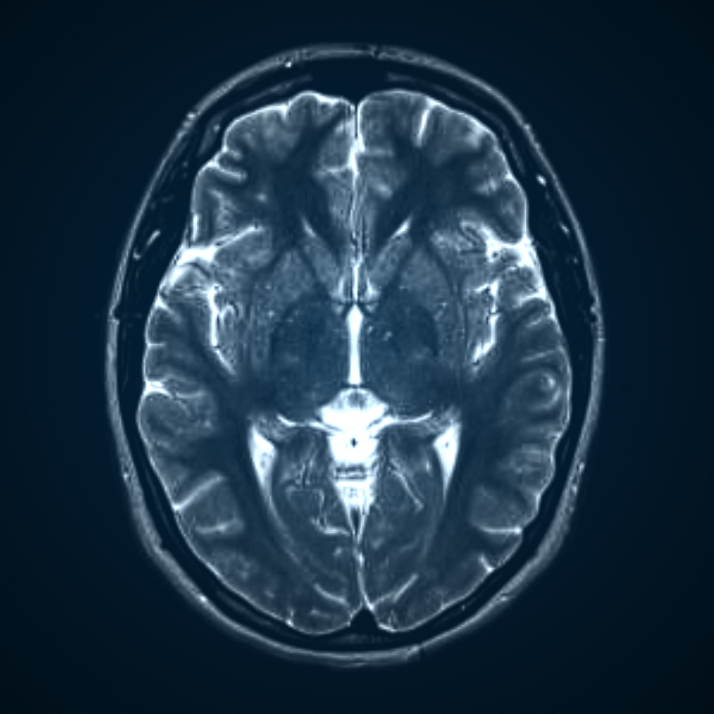
The human brain, with its intricate neural networks, is central to our nature. It governs our thoughts, emotions, and actions.

Slide 5
Shaped by Environment
Our surroundings and experiences greatly influence our development. Culture, society, and personal events shape our beliefs and behaviors.

Slide 6
The Power of Society
Human nature is also defined by our social connections and cultural norms. Our interactions and learned behaviors impact our sense of self and others.

Slide 7

The variety of human experiences and identities showcases the breadth of human nature. We are a diverse species with unique perspectives and backgrounds.

Slide 8
Resilience and Hope
Despite challenges, humans display incredible resilience and hope. We adapt, create, and persevere, showcasing our capacity for growth and change.

Slide 9
The Creative Mind
Human nature is inherently creative. We possess the ability to imagine, invent, and innovate, leading to advancements in art, science, and technology.

Slide 10
The Human Heart
Our capacity for love, joy, sadness, and empathy is profound. Emotions guide our actions and connections, shaping our relationships and sense of self.

Slide 11
Navigating Right and Wrong
Humans have a sense of morality, often striving for justice and fairness. Our ethical judgments influence our behavior and shape our societies.

Slide 12
Understanding Human Nature

Slide 14
Summary
• - Human nature is a complex interplay of biology, environment, and experiences, shaping our behaviors and thoughts.
• - Our nature is influenced by genes, evolution, and our diverse and unique environments and experiences.
• - The human brain, with its intricate neural networks, governs our emotions, actions, and thoughts, and our social connections and cultural norms play a significant role in shaping our nature.
• - Humans display incredible resilience, creativity, and emotional depth, with a moral compass guiding our sense of justice and fairness.
• - Understanding human nature helps embrace our shared humanity, celebrating our diversity and unique perspectives.

Slide 15
Next Steps
• Here are four suggested next steps for the audience following your presentation on human nature:
•
• 1. Reflect and Connect: Encourage the audience to reflect on their own unique experiences, identities, and perspectives, recognizing their place in the diverse tapestry of human nature. This personal reflection can lead to deeper connections with others, fostering a sense of shared humanity.
•
• 2. Explore and Learn: Suggest that audience members further explore specific areas of interest touched on in the presentation, such as the biological foundations of behavior, the impact of societal norms, or the creative and innovative capacities of humans. Provide additional resources, such as books, documentaries, or research articles, to deepen their understanding.
•
• 3. Embrace Diversity: Emphasize the importance of embracing and celebrating human diversity. Encourage open-minded interactions with people from different backgrounds, cultures, and beliefs to broaden one's perspective and challenge personal biases. This can lead to a more inclusive and empathetic society.
•
• 4. Inspire Positive Change: Motivate the audience to harness the resilience, creativity, and moral compass discussed in the presentation to drive positive change in their communities. This could be through volunteering, advocating for social justice, or simply being a force for good in their daily interactions, thus contributing to a better world.
•
• These action points aim to engage the audience in further exploration, self-reflection, and positive contributions to society, building upon the insights gained from your presentation on the fascinating subject of human nature.

